Slide 1
Wine Quality Prediction (Red Wine Dataset)
Supervised Machine Learning Case Study
By: Ashwin Jaishanker

Slide 2
Wine Quality Prediction
Objective: To analyze the physicochemical properties of red wine and predict wine quality using supervised machine learning models.
Models Used: Decision Tree & Random Forest Classifiers

Slide 3
Dataset Overview
Dataset consists of physicochemical properties of red wine samples
Target variable: Quality (integer score from 0 to 10)
Important features:
Fixed acidity
Volatile acidity
Residual sugar
Free sulfur dioxide
Alcohol
Goal: Understand how chemical composition affects wine quality.

Slide 4
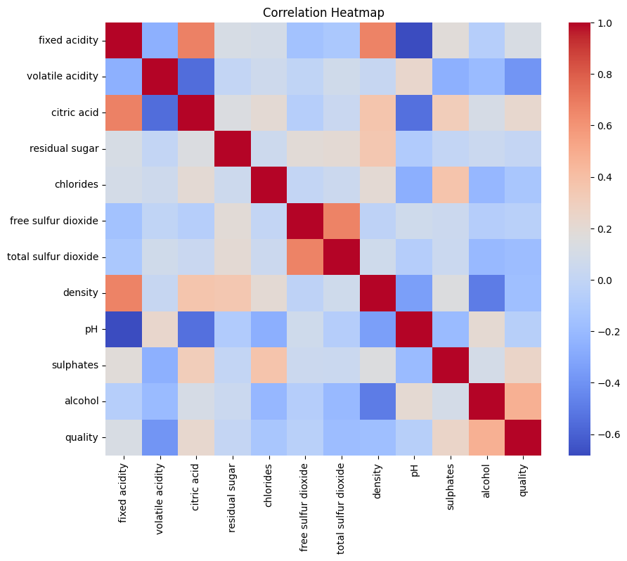
Exploratory Data Analysis
Key Observations:
Alcohol content shows strong positive correlation with wine quality
Volatile acidity shows negative correlation with quality
Some features are weakly correlated
Alcohol content shows a strong positive correlation with wine quality, while volatile acidity and sulfur dioxide levels exhibit negative correlation with quality.

Slide 5
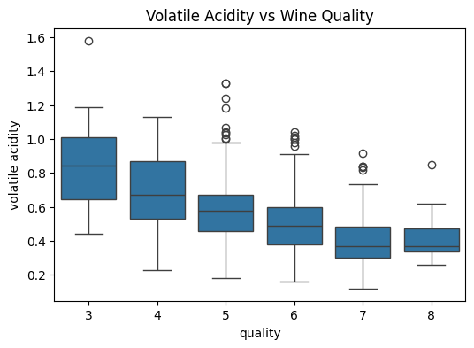
Feature vs Quality Analysis
Higher quality wines generally have:
Higher alcohol content
Lower volatile acidity
Volatile acidity has a noticeable impact on quality distribution
Wine samples with lower volatile acidity generally correspond to higher quality ratings, indicating a negative relationship between volatile acidity and quality.

Slide 6
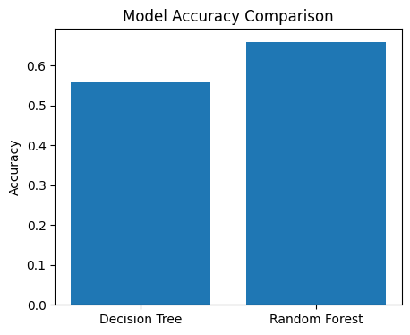
Model Training & Comparison
Models trained:
Decision Tree Classifier
Random Forest Classifier
Data split: 80% training, 20% testing
Result:
Random Forest achieved higher accuracy than Decision Tree
Random Forest achieves higher prediction accuracy than Decision Tree, demonstrating improved generalization through ensemble learning.

Slide 7
Conclusion & Insights
Wine quality can be effectively predicted using ML classifiers
Random Forest outperforms Decision Tree due to ensemble learning
Alcohol and volatile acidity are key indicators of wine quality
Conclusion: Random Forest is more suitable for predicting wine quality accurately.

